Slide 1
AI for Gaming Project
Anita Lim, Ayi Pranayanda, Farhan Irani

Slide 2
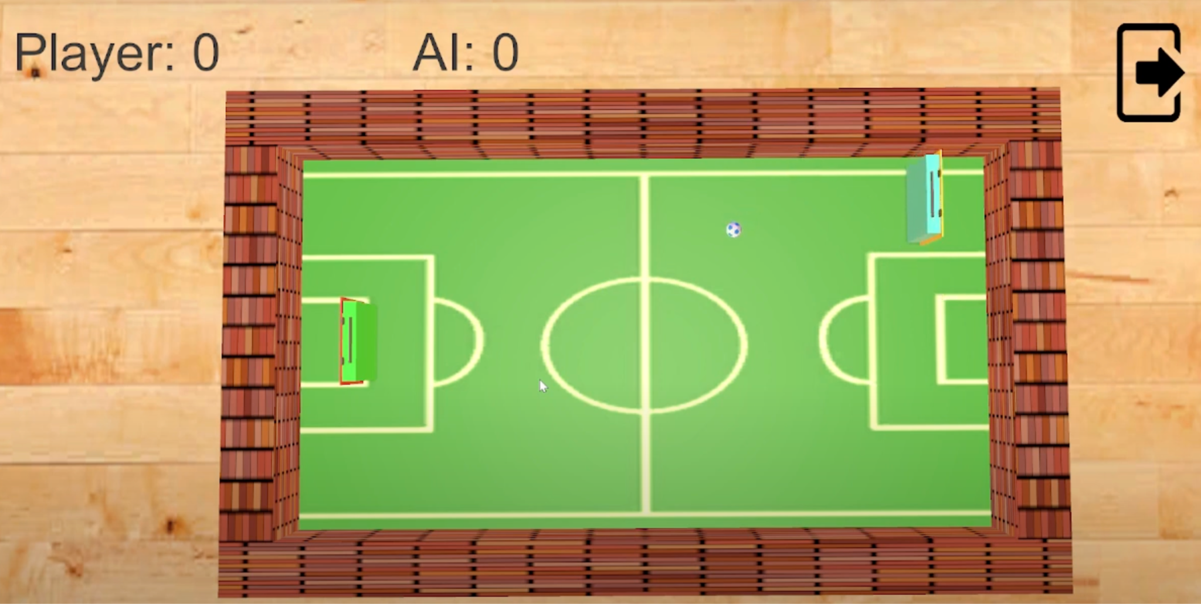
Game Choice
Notes:
Our team has made a decision to embark on the development of a short and simple Pong game that incorporates artificial intelligence (AI) techniques. The game will involve a simple and concise set of rules, with the objective of scoring points by hitting a ball back and forth between two paddles, one controlled by the player and the other by the AI.

Slide 3
AI Techniques Used and How?
Reinforcement learning
Trained the AI by:
Observing its own and the ball’s position
Positive reward when it collides with the ball
Negative reward when the ball gets past
Built a neural network model as its brain
Notes:
We will be using reinforcement learning AI techniques to create this game. We trained the AI using this technique by making sure that it is observing its own position and the ball's position. We are also giving the AI a positive award when it collides with the ball and a negative reward when the ball gets past the AI. After a certain number of sets, the AI will have built up a neural network model which will then be used as its brain in the game.

Slide 4
What Makes it Interesting?
Positive / Negative Rewards
Allows for longer and challenging gameplay
Notes:
The game is interesting to the player because it is known that a programmer did not have to tell the AI how to act. The AI learns what to do based on the reinforcements learning system with positive and negative rewards. The future plan is to have different brains trained at varied time lengths to create different difficulties for the player. The longer the AI trains, the harder it will be.
The game is also interesting because we have background music, sound effects, and textures that add juice to the game. When the player plays the game, there is a scoring system that determines who is the winner. In terms of the game mechanic, normal pong would be too boring which is why we made the pong ball move faster as time goes on to make it difficult for both the player and the AI.

Slide 5
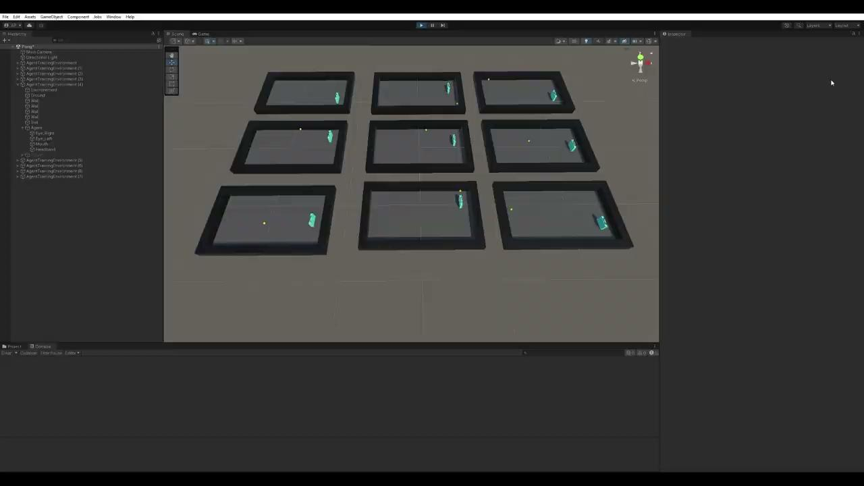
Training

Slide 6
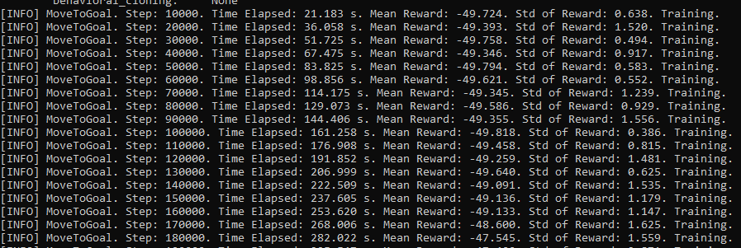
Beginning of Training

Slide 7
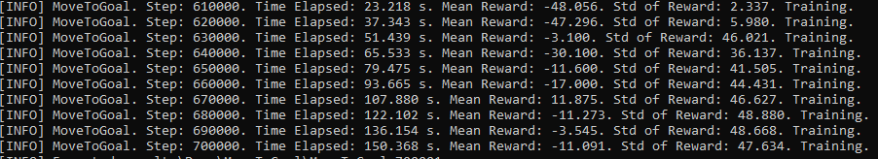
End of Training

Slide 8
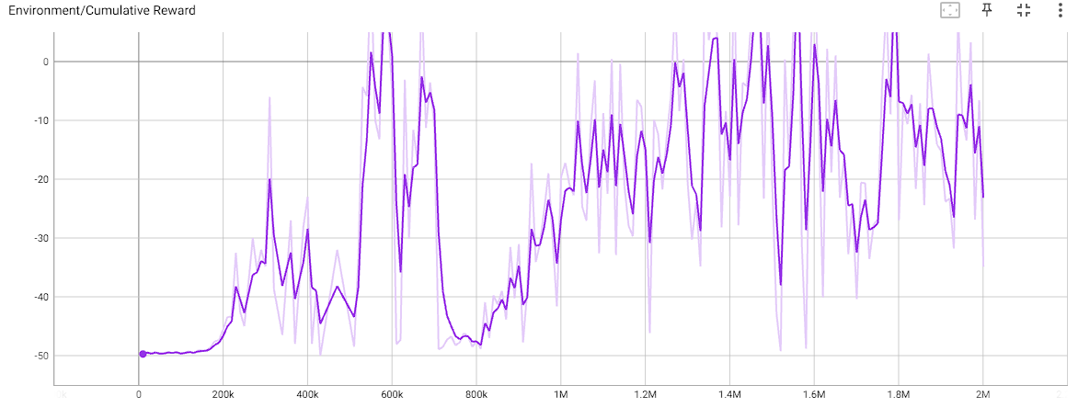
Rewards Graph
Notes:
Up to 500k was lowest speed
To 700k was next speed
And to 900k, the fastest speed

Slide 9
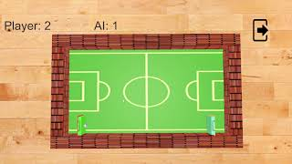

Slide 10
Thanks for listening!

